Slide 1

IDD SUPPORT SYSTEM
Team- Code Warriors
Sai Kale- NUID 001066779
Diksha Desai- NUID 001382558
Sayali Pathare- NUID 001029759

Slide 2
Objective
All people with intellectual and developmental disabilities (IDD*) have the right to live life in communities of their choosing where they can live, learn, work, and enjoy life. To achieve this, people with IDD need access to person-centered and self-directed high-quality long term supports and services (LTSS). Robust, reliable, and immediately accessible funding sources that include Medicaid are needed.
IDD Support system is helping such individuals to get necessary medical treatment and required employment training to standout in a society.

Slide 3
Issues & Its Solution
Issues: Individual with IDD faces multiple challenges and unemployment.
Solution:
In IDD Support System, we are providing two different services to the individual , Medicare Services and Training services.
We are assigning a Caregiver to an individual who is a responsible person for that Individual in both the cases.
Medicare services do the routine check-up and specialized medication course.
Training services provide employment training to the Individual.

Slide 4
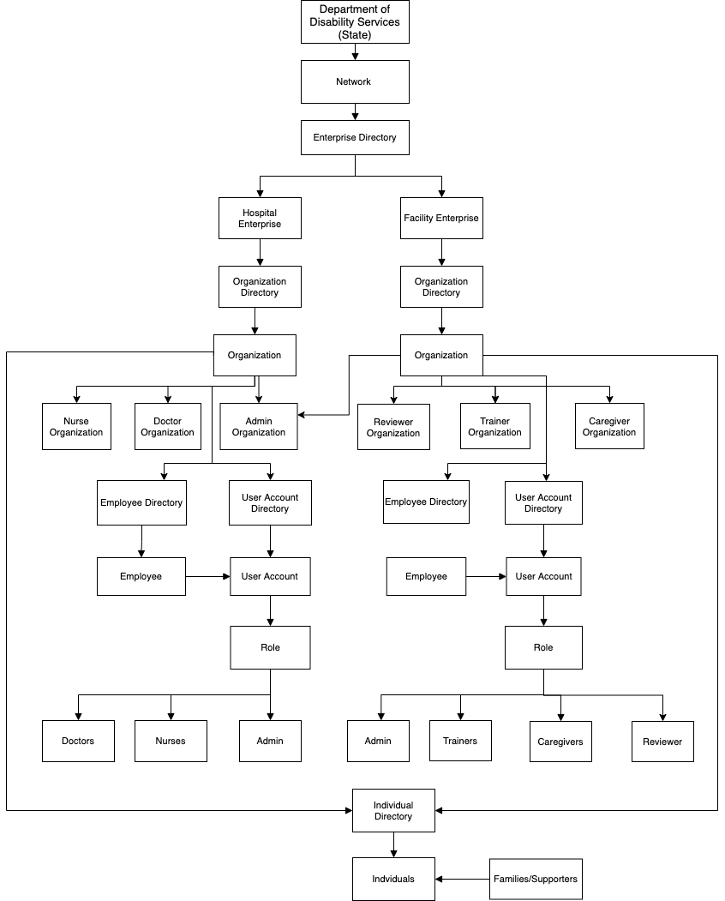
ECO System Architecture Diagram

Slide 5
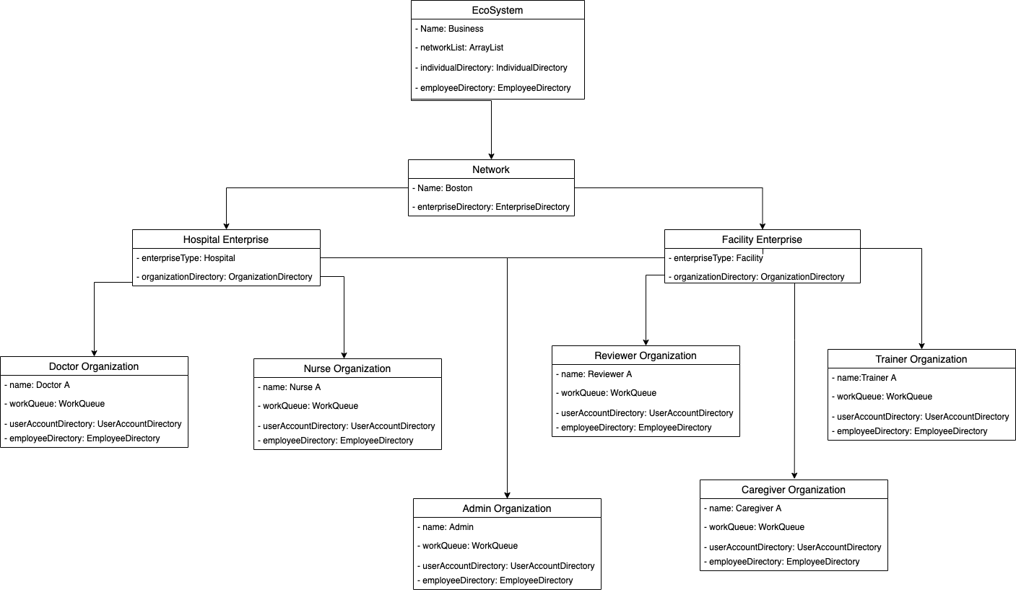
UML Diagram

Slide 6
Work-Flow
Medical Service:
Individual/Supporters Sign Up -> Individual Form Submission -> Selecting Facility -> Facility Reviewer assigns Care Giver
Caregiver schedules Doctor appointment -> Doctor completes appointment and inputs data -> Doctor assigns nurse
Nurse schedules multiple appointments depending on medication -> Nurse marks medication completed on behalf of doctor -> Caregiver marks request completed
Individual/Supporters provide feedback -> Facility Reviewer tracks feedback
Employment Service:
Individual/Supporters Sign Up -> Individual Form Submission(Condition above 18 age) -> Selecting Facility ->
Facility Reviewer assigns Trainer-> Trainer schedules multiple trainings -> Trainer marks training completed
Individual/Supporters provide feedback -> Facility Reviewer tracks feedback

Slide 7
Roles and Capability
System Admin: Create Network, Enterprise and Enterprise Admin
Hospital Enterprise:
Admin:
Create Doctor
Create Nurse
Doctor:
Schedule Appointment
Assign Individual to Nurse
Nurse:
Scheduling multiple meetings,
Track individual progress
Facility Enterprise:
Admin:
Create Reviewer
Create Caregiver
Create Trainer
Caregiver:
Schedule Appointment
Monitor Individuals progress
Trainer: Schedule Training
Reviewer:
Assign Caregiver,
Assign Trainer
Track Individual service feedback

Slide 8

THANK YOU

